Slide 1
Aero -Otico- Equilibrium
( The Journey of the ‘Stone legs’ to the ‘Jelly legs’ )
Health Care
+
Technology
Vestibular Issues of Astronauts
Time & Energy Investment
A sound Remediation to the Problems

Slide 2
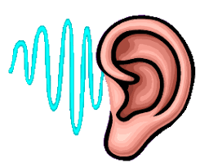

The Goal
To Focus on the Medical Issues , Specially Vestibular Problems faced by the Astronauts before, during, and after spaceflight and Implement the Idea of Aero-Otico-Equilibrium for the deep understanding and Remediation of persisting problems.

Slide 3

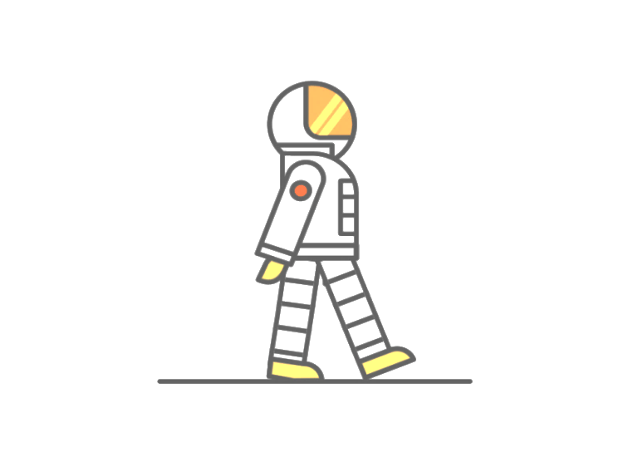
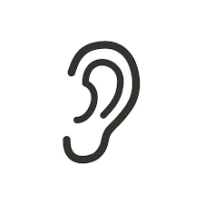
Why the Name Aero-Otico-Equilibrium ?
Sounds Unfamiliar ???
Aero (Space/Nautics)
Equilibrium
Balancing problems of Astronauts
Human effort in science, engineering and business to fly in the atmosphere of Earth (aeronautics) and surrounding space (astronautics).
Otico
Relating to the Ear

Slide 4
Introduction
Human travel to Mars and beyond is no longer science fiction. Astronaut’s performance are kept on high expectations , so they can be explorers, scientists, and operators.
Pondering upon the space sciences, we acquired lots of information regarding the body changes, Rehabilitation, the Importance of monitoring health, and how to determine the human body’s performance through the various sequences of launch, spaceflight, and landing.

Slide 5
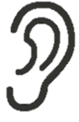
Astronaut’s Health
Astronauts change physically during spaceflight, from their brain, heart, blood vessels, eyes, and ears and on down to their cells.

Slide 6

Micro-Gravity
The most pervasive physiological human factor in all spaceflight
Notes:
An astronaut perceives weightlessness and floats along with any object, large or small.

Slide 7
Vision, Orientation, and Balance Change in Microgravity
The criticality to our existence on Earth is to rely on Earth’s gravity as a fundamental reference .Let it be a walk, run, jump, and otherwise move about without falling.
To support this, we have inbuilt specialized motion-sensing receptors in our inner ears—receptors that act like biological guidance systems.

Slide 8
Vision, Orientation, and Balance Change in Microgravity
Among other things, these receptors sense how well our heads are aligned with gravity. Our brains combine these data with visual information from our eyes, pressure information from the soles of our feet and position ,and loading information from our joints and muscles to continuously track the orientation of our bodies relative to gravity.
Knowing this, our brains can work out the best strategies for adjusting our muscles to move our limbs and bodies about without losing our balance.

Slide 9
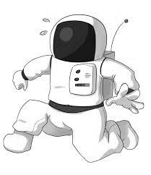
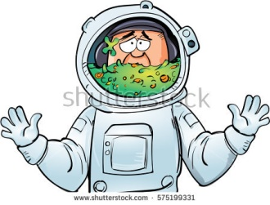
At the end of launch phase, astronauts find themselves suddenly thrust into the microgravity environment.
Gravity, these astronauts relied on throughout their lives for orientation and movement, suddenly disappears resulting consequences like Disorientation, perceptual illusions, motion sickness, poor eye-head/eye hand coordination, and whole-body movements are issues each astronaut has to deal with to some degree.

Slide 10
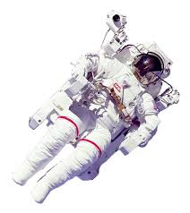
Red Alert
The lack of health care for former astronauts has long been a sore spot at NASA, but now it threatens the agency's future. Deep space missions beyond the moon, like a mission to Mars, require a better understanding of how extended spaceflight affects the human body.

Slide 11
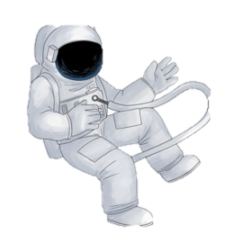
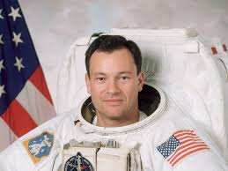
NASA astronaut Michael Lopez- Alegria flew to space four times for the space agency between 1995 and 2007. While in space, his eyesight deteriorated, a well-documented medical issue of NASA known about for years.

Slide 12
Human Vestibular System in Space
How do the important body senses change or adapt when we fly in an aircraft or enter the microgravity environment of low Earth orbit? Can these sensory and response systems, which work so well here on Earth, provide us with inaccurate and potentially harmful information when we fly as pilots or astronauts?
Let's find out!
NS

Slide 13
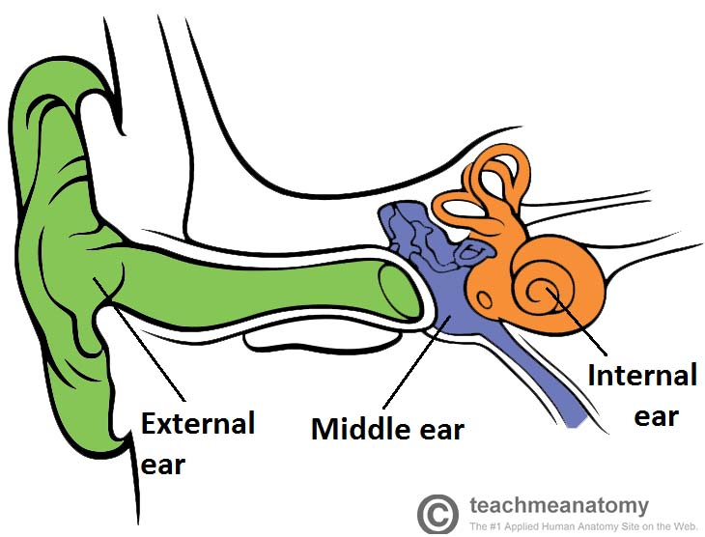
Anatomy in its briefcase
Ear
01
Outer , Middle , Inner ear
02
Inner ear
Consists -
Cochlea ( The Organ of hearing )
Vestibular system ( The Organ of Balance)
03
Vestibular System
Semi-circular canals
Utricle
Saccule
04

Slide 14
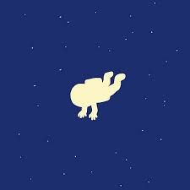
Why do Astronauts feel Dizzy?
The Otoliths needs pressure for them to work properly.
Without pressure in outer space, the otoliths no longer move back and forth; but if move , they do so independently of any force of gravity.
Consequently, the otoliths are unable to give the correct signal to the Astronaut’s brain.

Slide 15
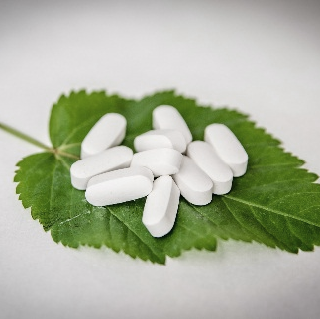
To help their bodies adapt to outer
space, astronauts take medication,
such as Gravol®.

Slide 16
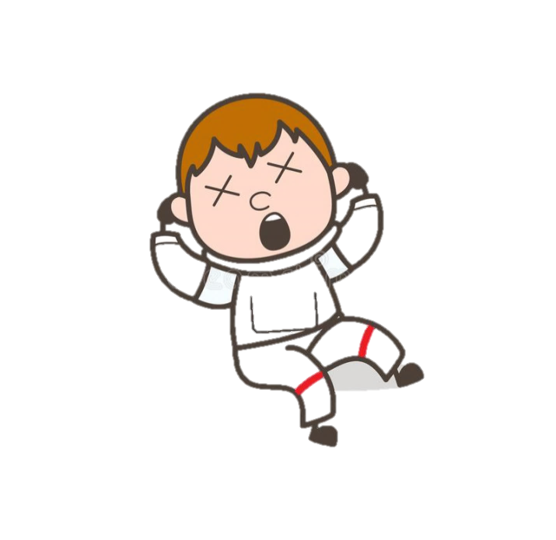
These medicines restrict the Astronauts from doing
strenuous or highly technical
tasks, such as operating
heavy machinery or
undertaking space walks, for the first 72 hours in
the Space Station.

Slide 17
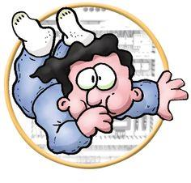
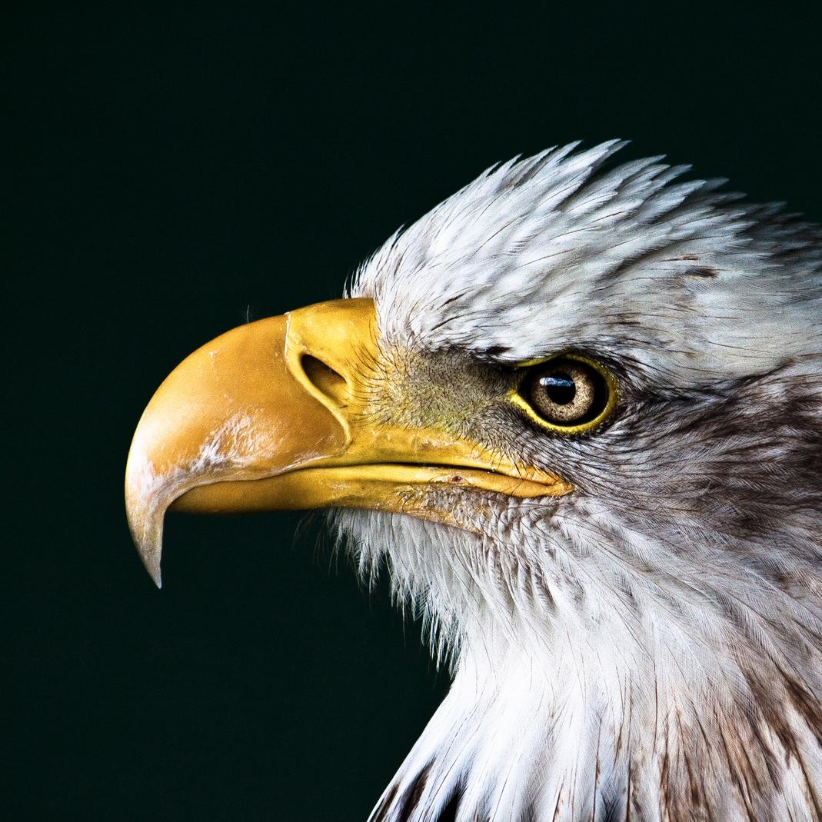
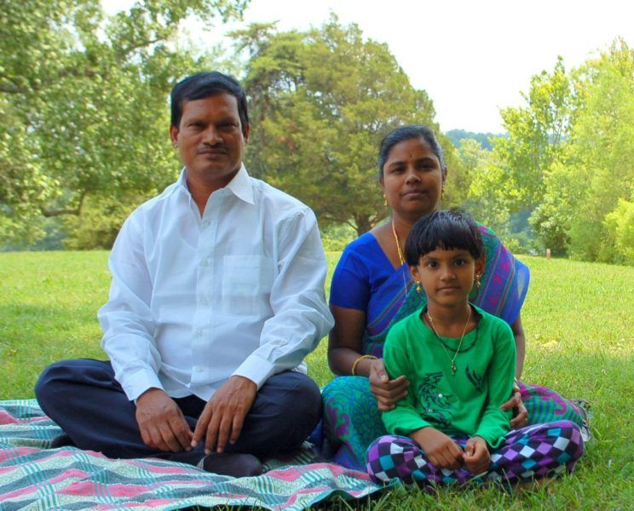
Matter to be Focused
The ability to develop techniques to prevent or reduce the
occurrence of
Space Motion Sickness (SMS)
is important for
increasing crew safety and
comfort, mission success, and
optimizing time and cost factors.
NS

Slide 18

What NASA has in its Medical Evaluation :

Slide 19
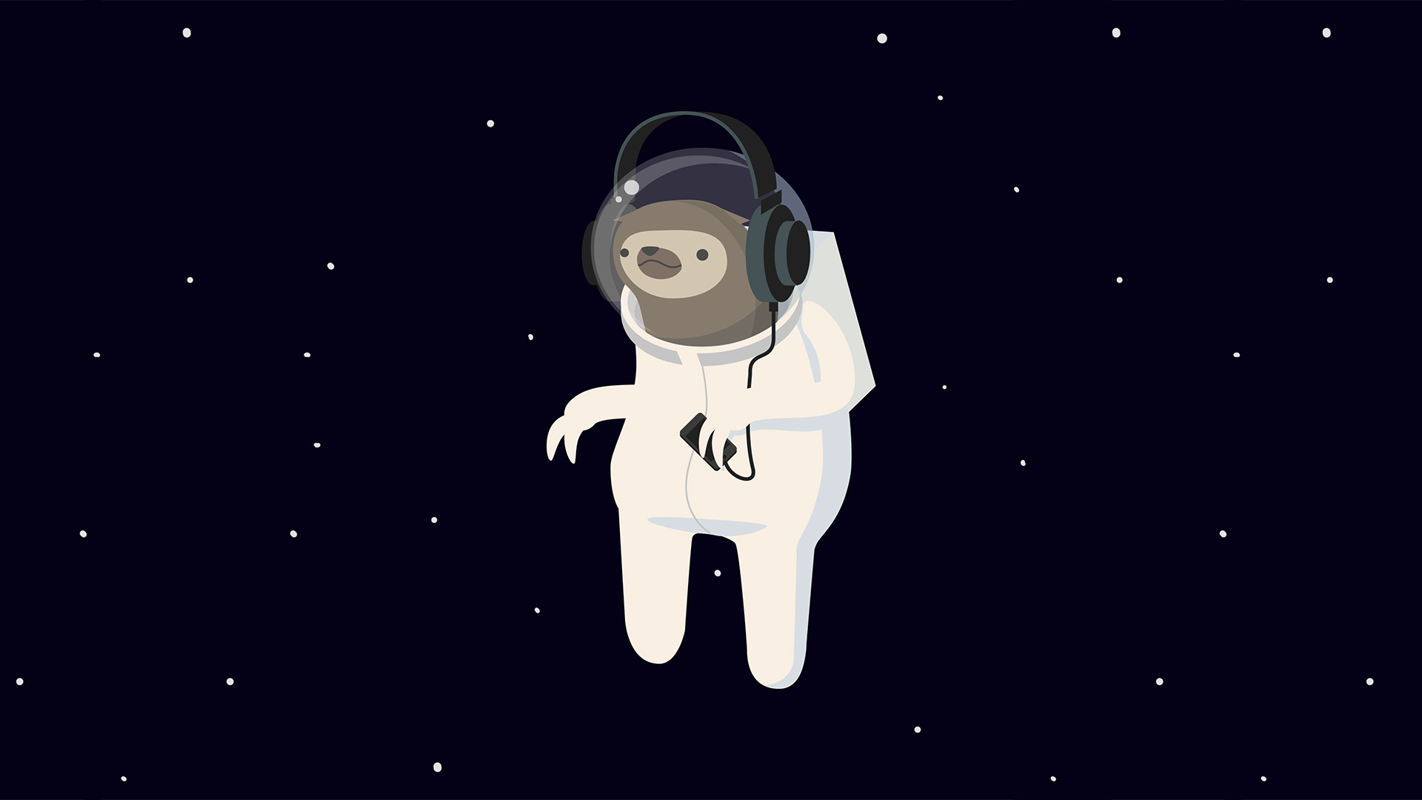
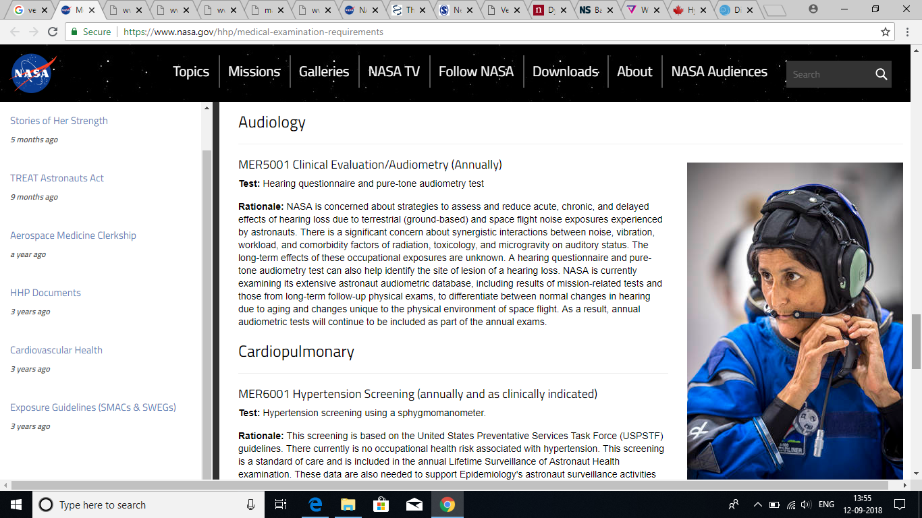
Thank you !

Slide 20
Laboratory Testing
Hematology (annually)
Biochemistry (annually)
Urinalysis (annually)
Ophthalmology/Optometry
Gastroenterology
Musculoskeletal
Bone Health (Every 3 years)
Dermatology
Audiology
Reproductive Health
Behavioural Health
Cardiopulmonary
.

Slide 21
What should be there : In Audiology
1. Hearing Checkup
2.
Vestibular Assessment
2 (b).
Assessment Exercises
PASS
2 (a).
Questionnaires
FAIL
Hierarchical steps involving the complete test for Hearing and balance

Slide 22
Pass/Fail Criteria for Rehab :
PASS
FAIL
Training for Pre-post Flight missions
Rehabilitation Measures
Compensatory Trainings
Adaptive Trainings
Reinforcement and rewards
Pre-Post Flight missions
In order to reduce the vestibular Issues following steps should be taken with the Therapeutic Training Instruments.

Slide 23
Pre-Flight Adaptive Trainings :
Visual Representation
with Optokinetic Response Methodology :

Slide 24


VR Viewer
Virtual Reality Screen
The Astronaut
Treadmill with a Latero-Medio-Lateral Motion from the axis
Chair for Optokinetic Response Recording

Slide 25
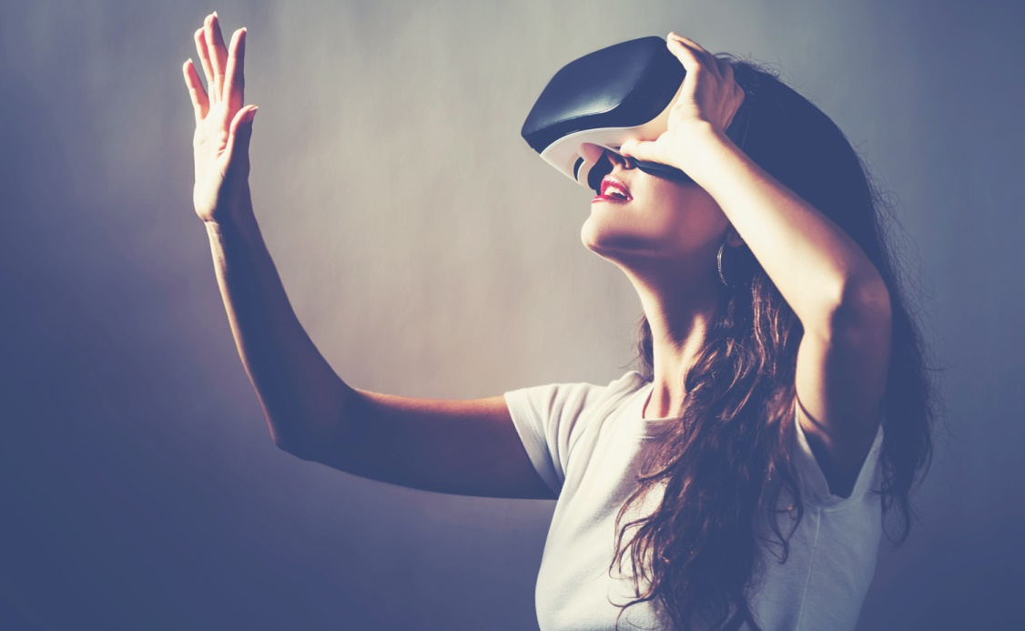
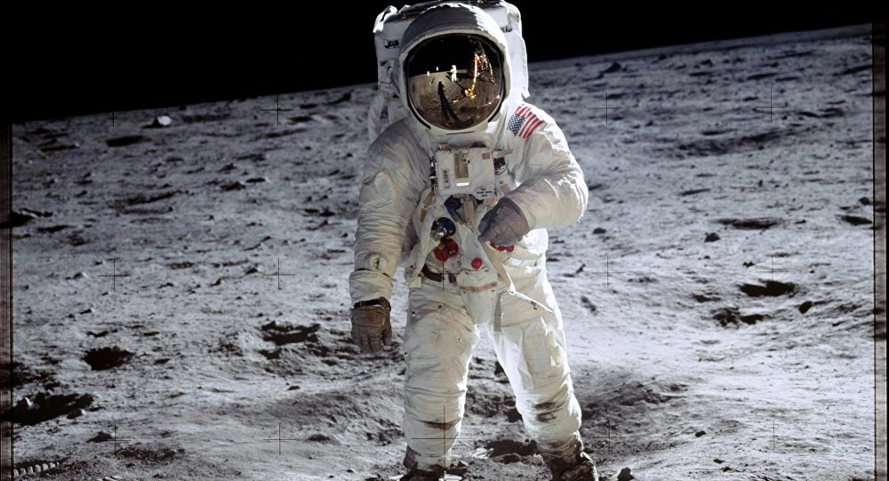
Virtual Reality Chamber devised up with Rotatory Chair :

Slide 26
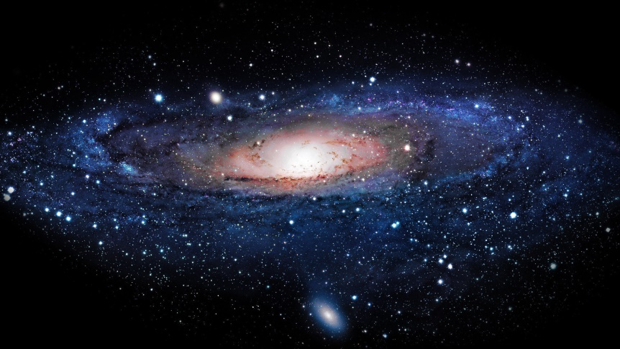
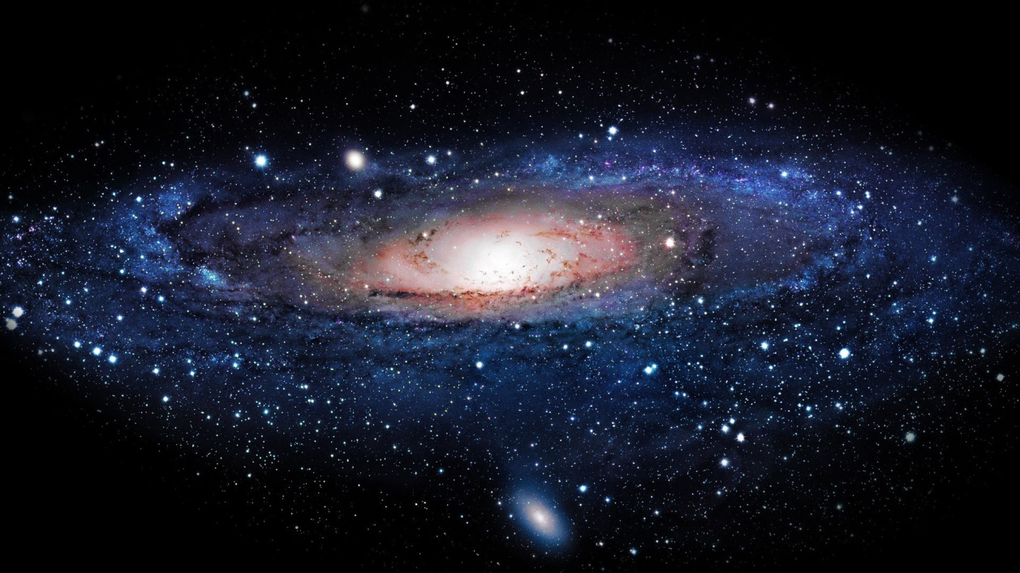
Enclosing VR Chamber
Virtual Reality Screen
Support Holder
Rotatory Chair

Slide 27
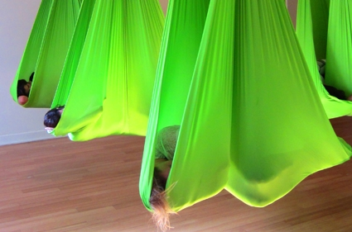
Anti-Gravity cocoon Yoga

Slide 28
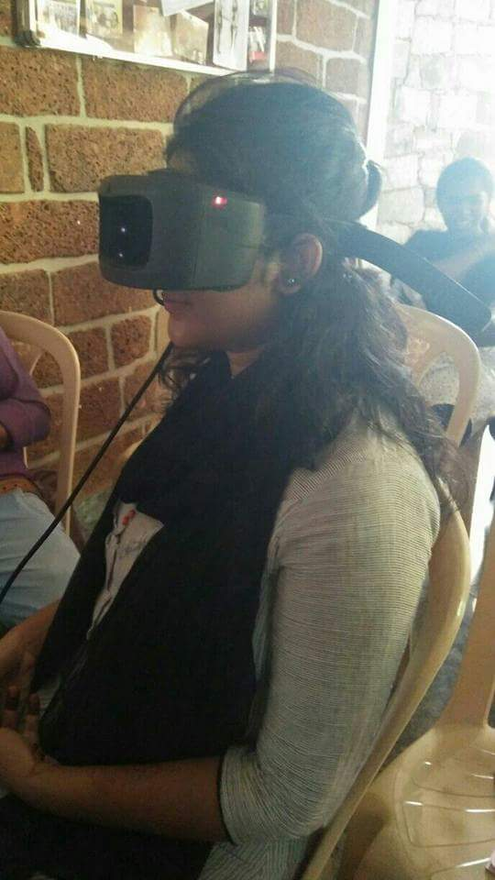
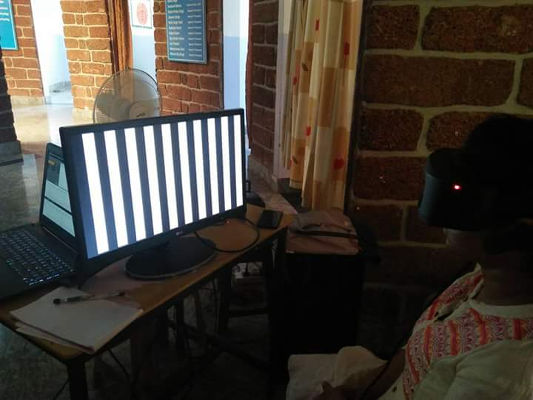
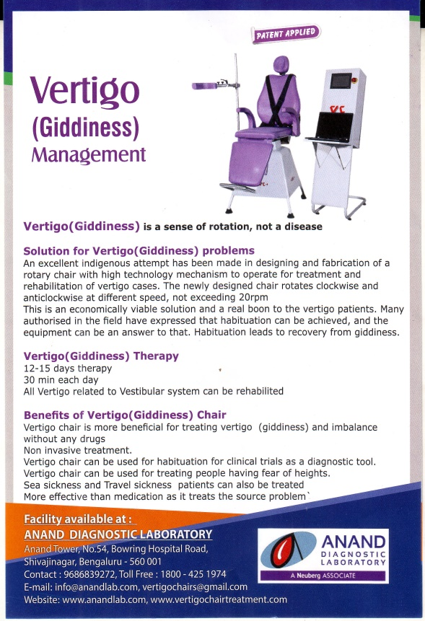
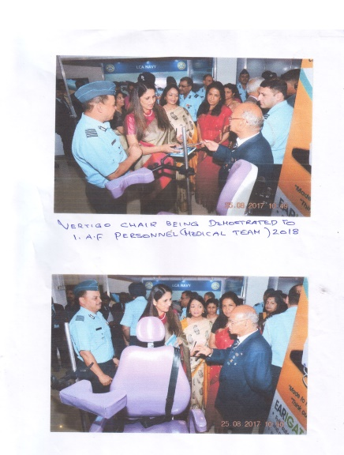
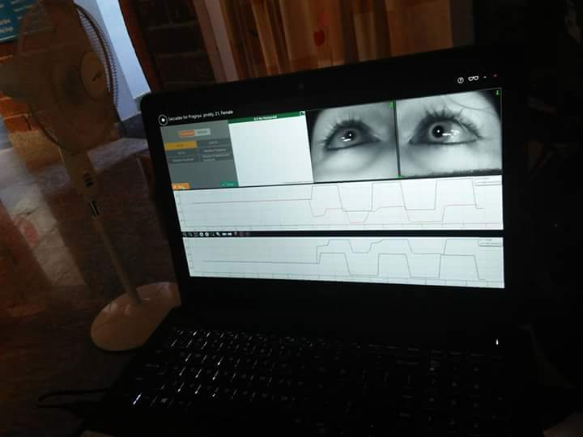
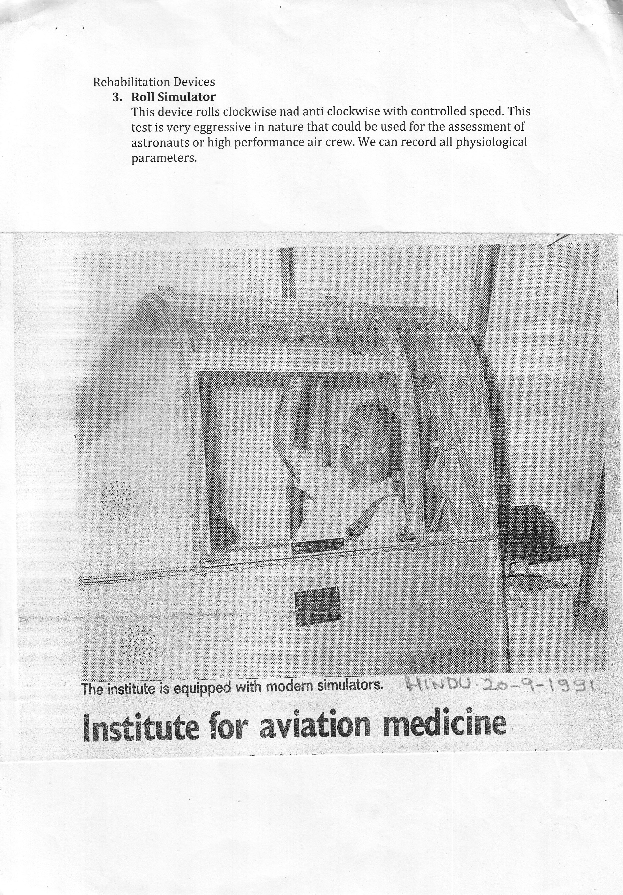
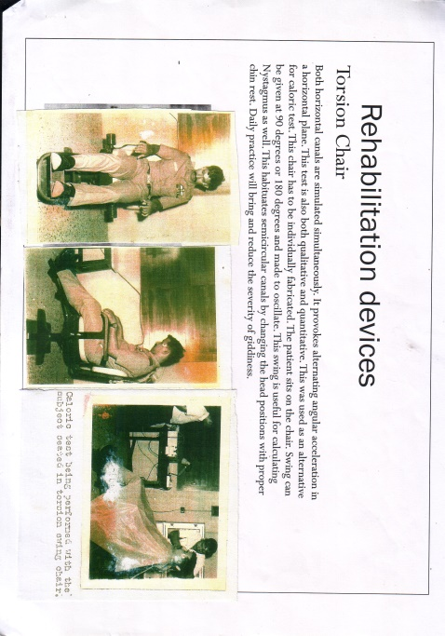
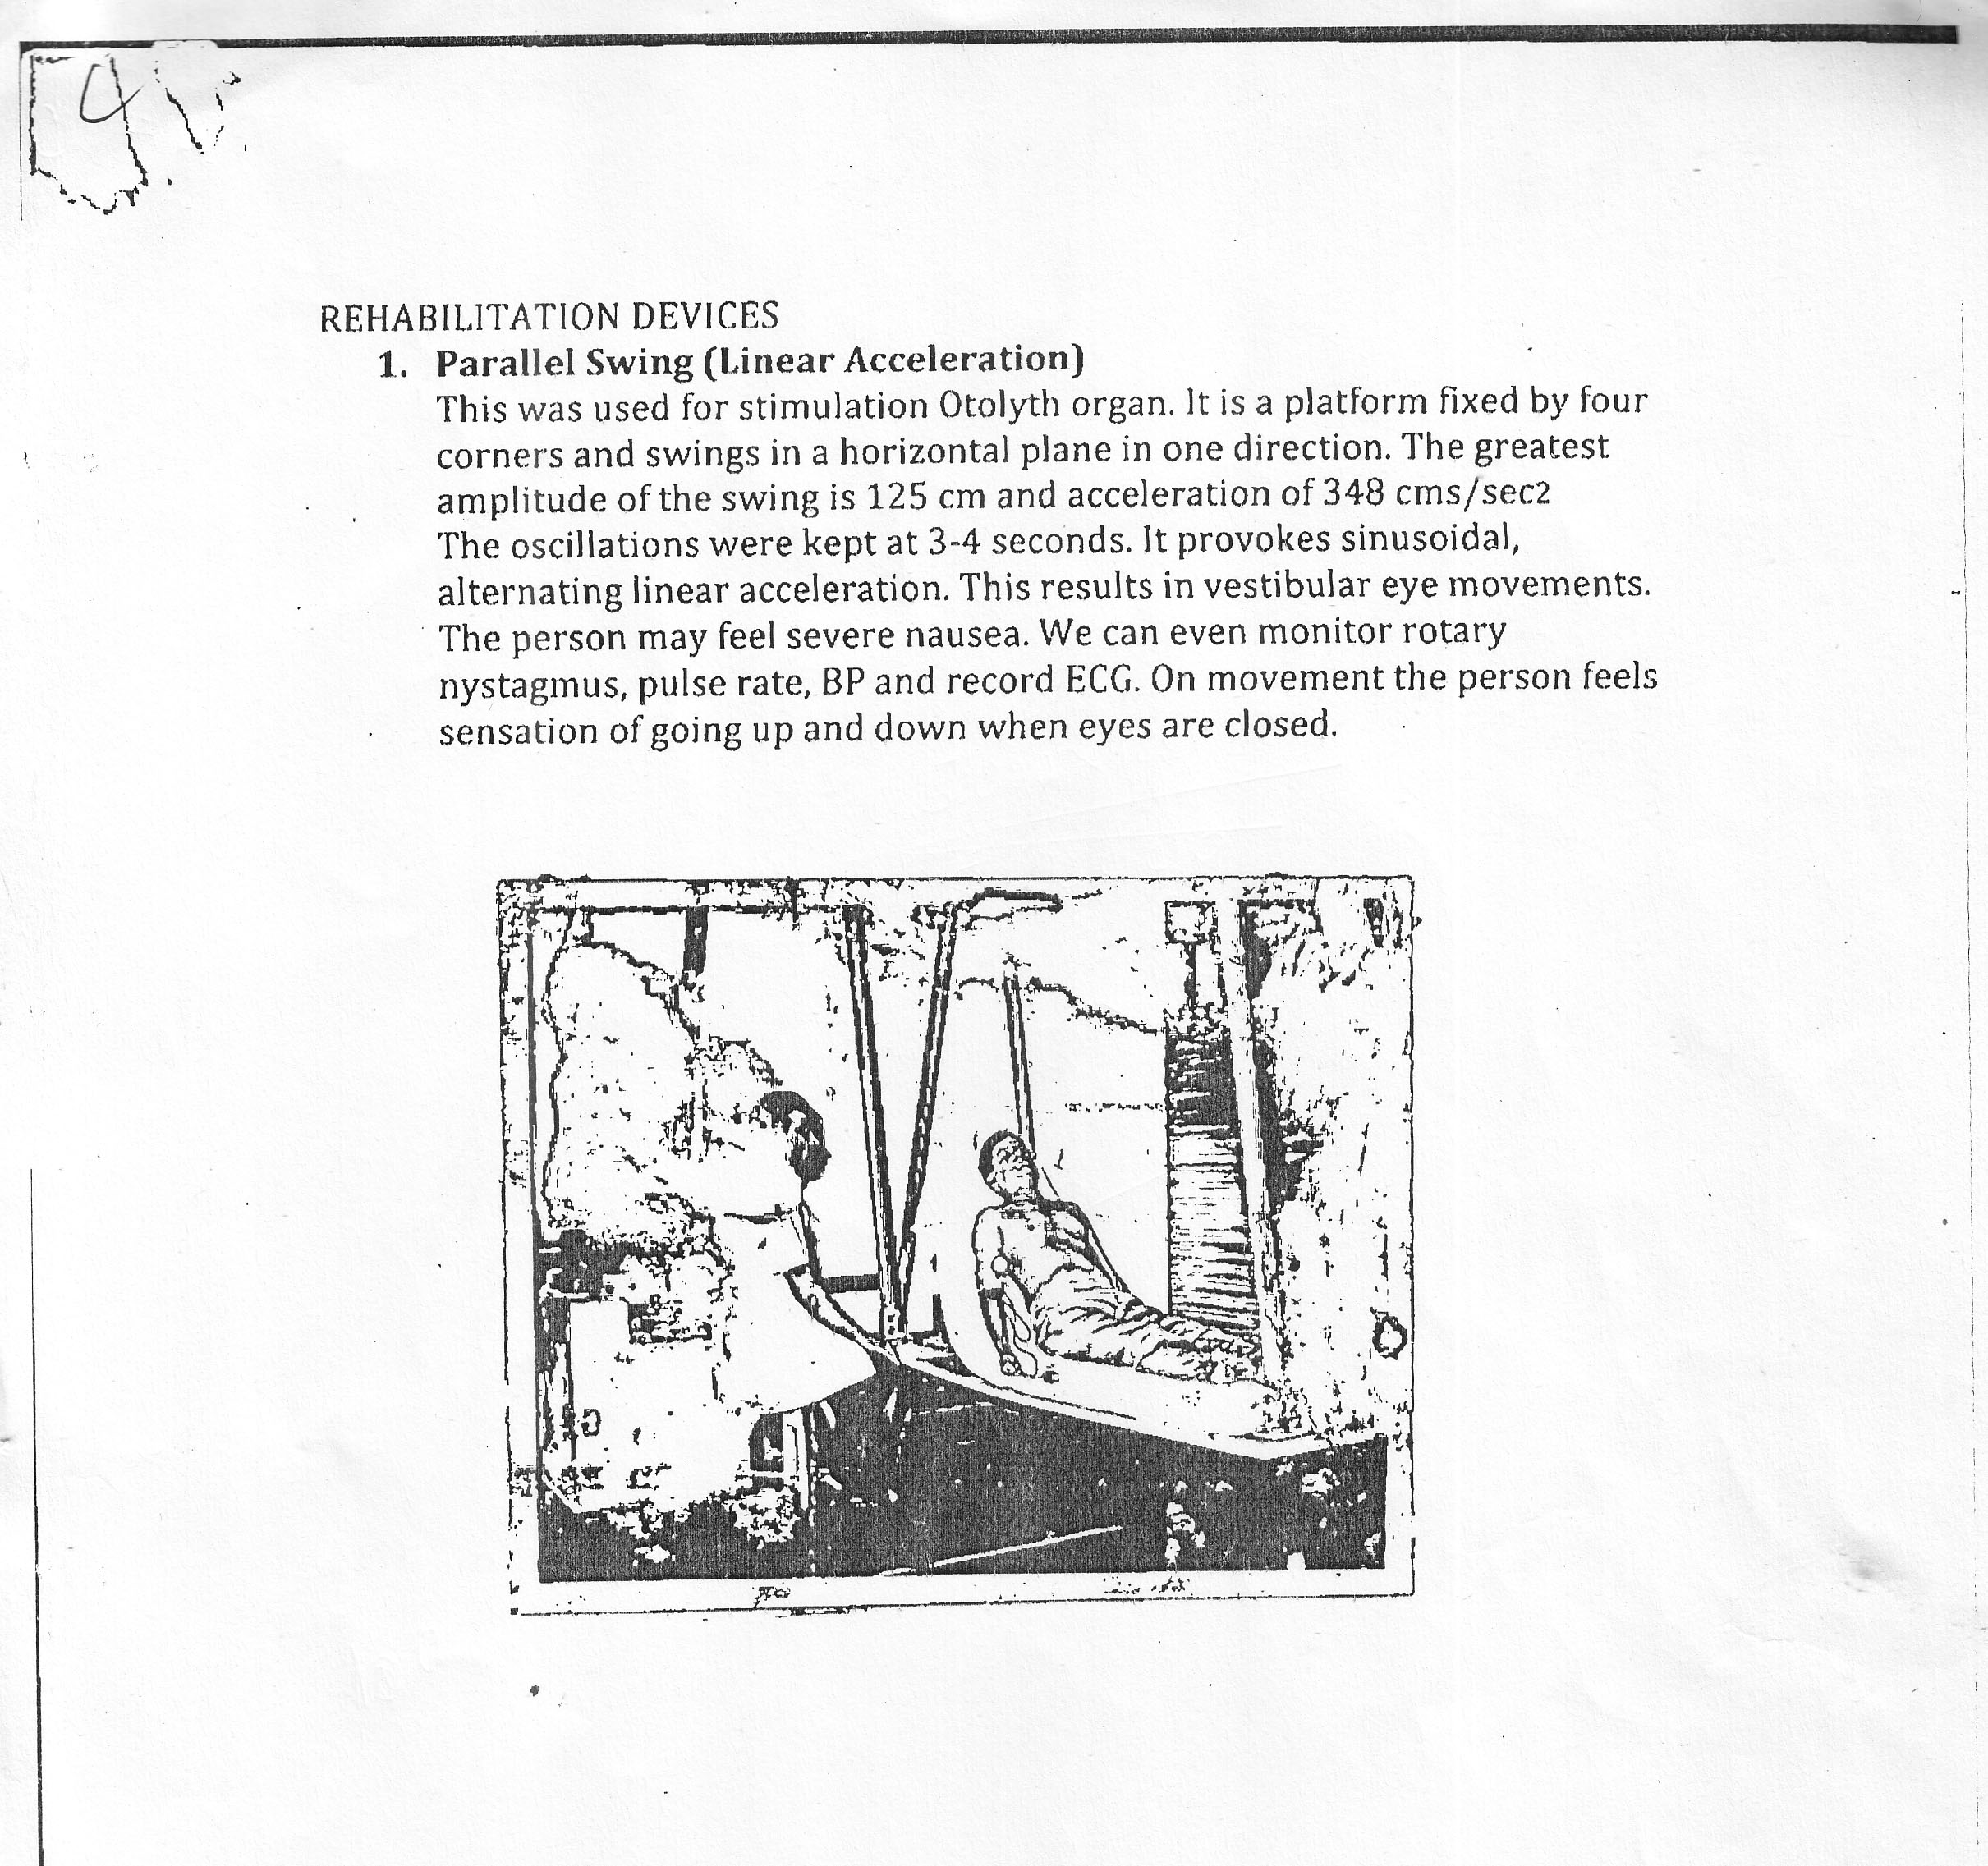

Slide 29
Thank you !

